Slide 1

Discriminative Graphical Models for Insurance Recommender Systems
RDBMS IA-1
2021011-Tanishk Krishnakant Shah

Slide 2
Problem
In current insurance market there are multiple policy options with different benefits available for people to choose from, which makes them confuse and miss the correct product.

Slide 3

Solution
Keeping problem in mind I propose auto insurance recommendation which helps consumer to select right product , right benefits at right price.
In the insurance industry, the motivation for creating a recommendation system stems from the urge to provide value for customers.
By connecting to customers through accurate and relevant recommendations, customer trust and loyalty could be increased
Notes:
Notes to presenter:
What is your purpose for sharing this reflection?
Is it at the end of a unit or project?
Are you sharing this reflection, at the attainment of a learning goal you set for yourself?
Is it at the end of a course?
State your purpose for the reflection or even the purpose of the learning experience or learning goal. Be clear and be specific in stating your purpose.

Slide 4

Implementation Strategy
Step1:- Information Gathering of Insurance Product.
4
3
Step 2:- Understand Market Potentials
2
Step3:- Information Gathering of Consumers.
1
Step4:- Filter and recommend product based on the information Gathering.
Notes:
Notes to presenter:
What steps will you be taking as a result of this learning experience?
Did you learn from any failed experiences? How will you do things differently?
What advice will you give to others so they can learn from your experiences?
How can you share what you learned with a real-world audience?
Some examples of next steps might be:
After delivering my first persuasive presentation, I am thinking about joining the debate team.
After making my first film, I’m considering entering it in our school film festival or local film festival.
After connecting with this career expert, I’d like to do some research on that career field because it sounds interesting to me.
This SmartArt allows you add images and text to help outline your process. If a picture is worth a thousand words, then pictures and words should help you communicate this reflection on learning perfectly! You can always click on Insert>SmartArt to change this graphic or select the graphic and click on the Design contextual menu to change the colors.
Feel free to use more than one slide to share your next steps. It also helps to add some video content to explain your message.

Slide 5
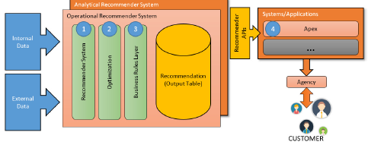
Project Schema

Slide 6
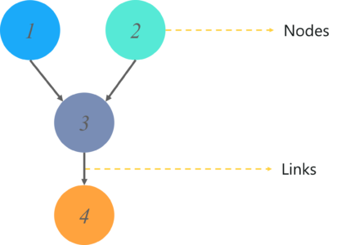
Bayesian Networks
A Bayesian Network falls under the category of Probabilistic Graphical Modelling (PGM) technique that is used to compute uncertainties by using the concept of probability. Popularly known as Belief Networks, Bayesian Networks are used to model uncertainties by using Directed Acyclic Graphs (DAG).

Slide 7
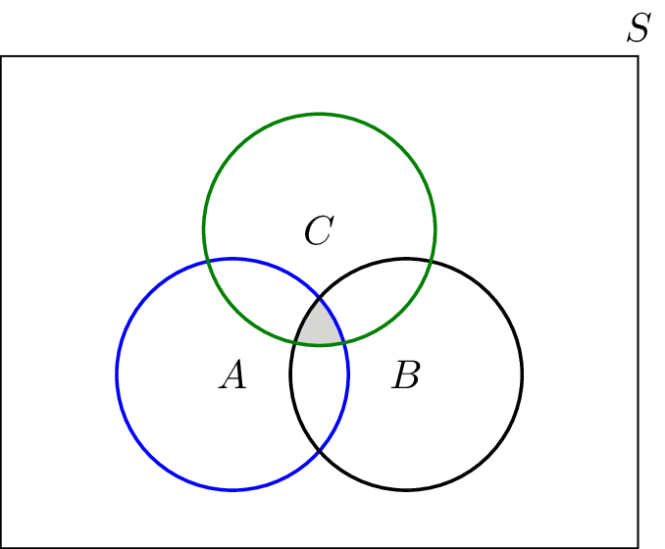
Joint Probability
Joint Probability is a statistical measure of two or more events happening at the same time, i.e., P(A, B, C), The probability of event A, B and C occurring. It can be represented as the probability of the intersection two or more events occurring.

Slide 8
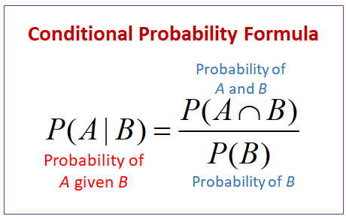
Conditional Probability
Conditional Probability of an event X is the probability that the event will occur given that an event Y has already occurred.
p(X| Y) is the probability of event X occurring, given that event, Y occurs.
If X and Y are dependent events then the expression for conditional probability is given by: P (X| Y) = P (X and Y) / P (Y)
If A and B are independent events then the expression for conditional probability is given by: P(X| Y) = P (X)

Slide 9
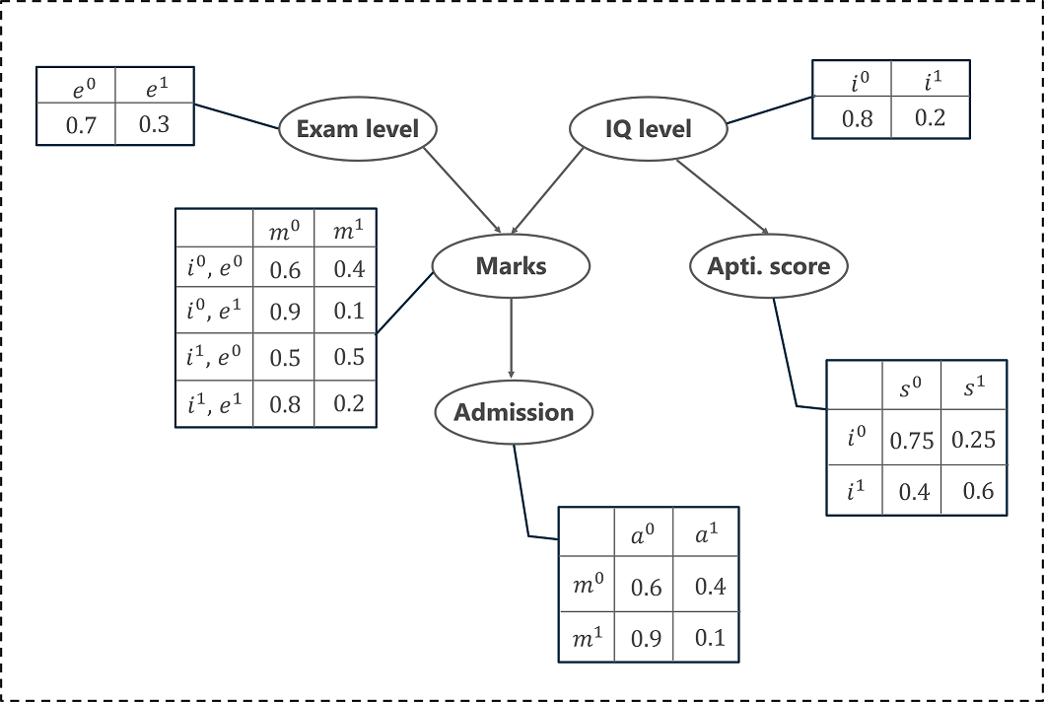
Example
Exam level (e): This is a discrete variable that can take two values, (difficult, easy)
IQ of the student (i): A discrete variable that can take two values (high, low)

Slide 10
Continue…
Here,
p(a | m) represents the conditional probability of a student getting an admission based on his marks.
p(m | I, e) represents the conditional probability of the student’s marks, given his IQ level and exam level.
p(i) denotes the probability of his IQ level (high or low)
p(e) denotes the probability of the exam level (difficult or easy)
p(s | i) denotes the conditional probability of his aptitude scores, given his IQ level

Slide 11
Directed Acyclic Graph
Directed acyclic graphs (DAGs) are used to model probabilities, connectivity, and causality. A “graph” in this sense means a structure made from nodes and edges.
Nodes are usually denoted by circles or ovals (although technically they can be any shape of your choosing).
Edges are the connections between the nodes. An edge connects two nodes. They are usually represented by lines, or lines with arrows.

Slide 12
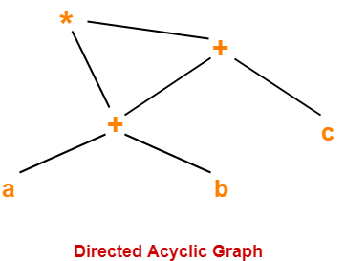
Example
For Example:-
( a + b ) x ( a + b + c )
Three Address Code for the given expression is-
T1 = a + b
T2 = T1 + c
T3 = T1 x T2
Directed Acyclic Graph

Slide 13

Implementation Process
Learn Splitting data techniques and how to sort order wise
Try to implement real time Recommendations
01
04
02
Recommendation incase better policy/product is available at the time of renewal
Real Time updation on benefits to customer
03
Notes:
Notes to presenter:
What did you think at first?
What obstacles did you encounter along the way?
How did you overcome those obstacles?
What images can you add to support your process?
This SmartArt allows you add images and text to help outline your process. If a picture is worth a thousand words, then pictures and words should help you communicate this reflection on learning perfectly! You can always click on Insert>SmartArt to change this graphic or select the graphic and click on the Design contextual menu to change the colors.
Feel free to use more than one slide to reflect upon your process. It also helps to add some video of your process.

Slide 14
References
Paper:- https://ieeexplore.ieee.org/document/8614094
Bayesian Networks:- https://www.edureka.co/blog/bayesian-networks/
Directed Acyclic Graph:- https://www.gatevidyalay.com/directed-acyclic-graphs/

Slide 15
Thank You

